Slide 1
AAPG Presentation –
Commission & Committee Internal Organization

Slide 2
INTRODUCTION OF TOPICS:
Policy Manual Process
Succession Planning
New Member Onboarding
Continuing Education
Annual Board Performance Assessment
Document Management & Disclosure
Minute Taking
Notes:
Introductory slide: highlight topics that will be covered. Mention that you will stop for questions after each topic or set of topics.

Slide 3
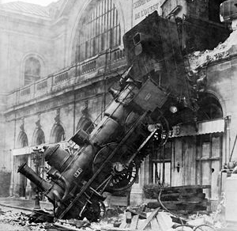
Writing Policies & Procedures Manuals Started As A Way To Prevent Train Wrecks
Notes:
(This section deals with the topic of the policy manual process)
Did you ever wonder who started writing policies and procedures manuals and why? Well in America at least, it seems the railroads started writing policies and procedures as a way to prevent train wrecks (reference: “Control Through Communication: The Rise of System in American Management” – JoAnne Yates). Starting in the 1890’s, the railroads sought to achieve better control of business processes and outcomes by imposing “system” through controlled communication. In seeking ways of improving safety and efficiency, these industries pioneered the practise of writing policies and procedures down and sharing standard best practises. No one had done that before! By creating standard operating policies and procedures and distributing them to all employees, the companies could better coordinate and standardize their operations – and thus prevent major problems (aka train wrecks) as their operations grew increasing complex and geographically spread out.
Organizations need standardized operations and clear policies and procedures as much today as they did back in the 19th & 20th centuries. Technology has changed, but the core needs have not. Good systems clearly communicated is still key to operations success and avoiding “train wrecks”.

Slide 4
“A policy manual is a foundational document for operations within any police department”.
Notes:
It is well known that it is standard practise for police departments to have a policy and procedure manual. The Internal Association of Chiefs of Police states: “A policy manual is a foundational document for operations within any police department”. An effective policing manual is a requirement to ensure safety and professionalism (your officers can’t comply with your Service’s standards if they don’t know them). So, it would stand to reason that the governance and oversight bodies for police Services would also have a set of policies and guidelines that address their role and responsibilities. (add: slide)
Establishing a policy framework will aid Committees and Commissions to effectively govern their police agencies and should provide a broad range of guidance to internal processes and insure that any issues arising can be dealt with in a proper perspective.
Secondly, the case for building a policy framework is that your policies will add emphasis or meaning to your set of vision, mission and values for your organization. Policies should also address your strategic or organizational goals.
Sometimes it’s hard to know where to begin when creating a new policy manual and framework. Do you use policies of similar agencies as reference points? Where do you find the most up to date legal, regulatory and legislative information to inform you content? Will your policies hold up to a challenge? Crafting effective policies takes planning, research and vision, but the process doesn’t have to be painful.
Policies need to be more than a list of rules for your Commission/Committee and employees to follow. At the core of a good policy it should communicate the mission, values and guiding principles of your organization.
This philosophy behind writing a policy matters because policies and procedures can never address every possible situation your organization will face. Well-written policies help guide decision-making and strives to address all anticipated risks.

Slide 5
Alberta Policing Oversight Standards For Municipal
Police Commissions:
Intent of the Policy/Procedure Manual
Legislative Obligations of the Oversight Agency
Role & Responsibilities of Oversight Members
Roles & Responsibilities of Chair & Vice Chair
Roles & Responsibilities of the Public Complaint Director
Orientation & Training New Members
Public Complaints Process
Conduct/Ethics & Conflict of Interest
Police Commission/Policing Committee Yearly Plan of Objectives
Police Commission/Policing Committee Yearly Reports of Achievements
Oversight Member Remuneration (if any)
Financial Management
Records Management
Communication & Media Relations
Notes:
Step 1 is to get organized and identify the key policies required for your organization. Not all policies are created equal and certain policies are more important than others in laying the groundwork for a comprehensive framework. You will need to make a list of all policies you will require that address national, provincial and local (municipal) laws and regulations.
For example, the Alberta Justice & Solicitor General has produced the “Alberta Policing Oversight Standards For Municipal Police Commissions”. This Commission oversight audit version states that compliance with applicable standards is mandatory and that an oversight agency shall have a written policy and procedures manual addressing provincial oversight standards that include, at a minimum, the following sections:
Intent of the Policy/Procedural Manual
Legislative Obligations of the Oversight Agency
Role & Responsibilities of Oversight Members
Roles & Responsibilities of Chair & Vice Chair
Roles & Responsibilities of the Public Complaint Director
Orientation & Training of New Members
Public Complaint Process
Conduct/Ethics & Conflict of Interest
Police Commission/Policing Committee Yearly Plan of Objectives
Police Commission/Policing Committee Yearly Report of Achievements
Oversight Member Remuneration (if any)
Financial Management
Records Management
Communication & Media Relations

Slide 6
Alberta RCMP Policing Committee Handbook:
Selection & appointment of policing committee members.
Policing Committee responsibilities.
How and when policy should be reviewed.
Expecting policing committee member conduct
Dealing with conflict of interest.
How the committee works to orient and train new members.
Roles & responsibilities of the Chair and Vice Chair.
Role of the local Public Complaint Director and the role of the committee regarding complaints against the Chief.
The nature and frequency of committee meetings and who attends.
How information is communicated internally and externally.
The expectations of the Policing Committee’s Annual Plan.
Notes:
The Alberta RCMP Policing Committee Handbook also states that every policing committee should have a policy manual that delineates the general structure and function of their organizations. They outline that their policy manuals should clarify such things as:
Selection & appointment of policing committee members.
Policing committee responsibilities.
How and when policy should be reviewed.
Expected policing committee member conduct.
Dealing with conflict of interest
How the committee works to orient and train new members.
Roles and responsibilities of the Chair and Vice Chair.
Role of the local Public Complaint Director and the role of the committee regarding complaints against the police.
The nature and frequency of committee meetings and who attends.
How information is communicated internally and externally.
The expectations of the Policing Committee’s Annual Plan.

Slide 7
3.1.6 RESPECTFUL WORKPLACE
The Edmonton Police Commission (“Commission”) is committed to creating and maintaining a vibrant, healthy, safe and caring work environment for all Commission employees. The Commission promotes a work environment free from discrimination or harassment, one in which everyone treats each other with respect and dignity.
Harassment in the workplace creates an intimidating and offensive climate, is a form of discrimination, affects individual’s dignity and self-esteem, and will not be tolerated by the Edmonton Police Commission.
The Commission upholds all laws in place including, but not limited to, the Human Rights Act for the Province of Alberta.
Notes:
There will also be ongoing legislative and regulatory changes that may drive development or revisions to existing policies within your organizations.
An example that the Edmonton Police Commission dealt with last year were the changes to the Alberta Health & Safety Act which came into effect on June 1st, 2018. These changes included incorporating a definition for harassment to address workplace harassment and bullying. Amendments to the Code provided further guidance on implementing the expectations set out in the new Act including the requirement to develop violence and harassment prevention plans that include policies and procedures. As we did not have a policy at that time that specifically dealt with these issues one was developed, our new “Respectful Workplace” policy.
(Note: this is only a small portion of the entire EPC policy which also includes definitions, guidelines and procedures).

Slide 8
7.0 Public Complaints
The Calgary Police Commission accepts and processes public complaints in accordance with the Police Act.
In furtherance of this role, the Public Complaint Director is responsible for the administration and review of public complaints, on behalf of the Commission, and for meeting the responsibilities set out in section 28.1(3) of the Act.
The Public Complaint Director shall attend the public complaint training provided by the Ministry of Justice and Solicitor General. The Commission shall facilitate this attendance.
The Public Complaint Director shall ensure that the public complaint brochure distributed by the Commission and the Calgary Police Service, in accordance with the Provincial Policing Standards, provides accurate, up-to-date information on the public complaint process.
Notes:
You will also need to determine if detailed administrative procedures will be required and should be part of the policy you are developing. They are more likely to be required to support internal facing policies. These types of policies usually require clear guidance on how the policy will be implemented and by whom.
For example, a policy regarding receiving public complaints will require a set of procedures detailing how complaints will be handled.
Again, this is only a small excerpt from the Calgary Police Commission’s policy on Public Complaints. The entire document is approx. 4 pages long and outlines guidelines and processes that deal with communication/liaison protocols, review processes, alternative dispute resolution and requests for disclosure, just to name a few.

Slide 9
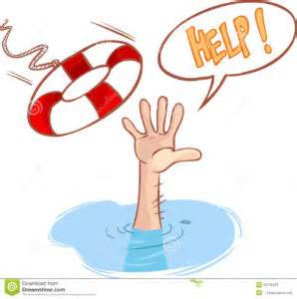
“Standard Operating Procedures:
Straight Jacket or Lifeline?”
Human activity is at the core of your organization’s operations. Your organization’s system is defined by the following:
Specific tasks individuals perform
Interaction between groups
Flow of work and information
Policies and standards applied
Divisions of responsibility, accountability & authority
Notes:
Standard operating procedures exist to help your employees perform better – NOT to tie their hands and shut down their minds. When writing policies and procedures, keep the bigger purpose in mind – you are trying to help good people get better results. This simple shift in attitude will help guide you to develop more effective, user-friendly policies and procedures that people will view as a life line.
The following points should keep you on the right track:
Remember specific tasks individuals perform
The interaction between individuals, groups and departments
The flow of work and information/communication protocols
Current policies and standards that need to be applied
And, finally, the divisions of responsibility, accountability and authority.

Slide 10

Write for an audience who do not know how to perform the task.
Present information in a logical order or sequence.
Try to anticipate possible problems, issues or concerns in advance of the final draft.
Notes:
Writing policies and procedures that get good results is not as hard as some people want to make it seem. If you apply common sense and apply the following 3 key elements you can easily produce effective procedures that will work for your organization in standardizing its operations:
Write for an audience who do not know how to perform the task.
Present information in a logical order or sequence.
Try to anticipate possible problems, issues or concerns in advance of the final draft.

Slide 11
DON’T:
Get mired in the details
Mix up policy & procedure information
Forget to review regularly
Notes:
DON’T:
Get mired in the details – instead of focusing on writing everything but the kitchen sink then sticking it on a shelf, concentrate on creating “good systems” that are intentionally designed to drive good performance outcomes.
Mix up policy & procedures information – not having a clear understanding of the difference between policy & procedures is where most people get into trouble.
Remember a “POLICY” is a guideline or statement of position with respect to a given topic and a “PROCEDURE” is a set of steps or instructions for completing a task. They are the “how to’s”. Remember also that a “Policy Manual” & “Procedure Manual” can be 2 separate stand-alone documents that just need to cross-reference one another.
3. Don’t forget to regularly review your policies and procedures to ensure compliance with current legislation, regulations, laws, processes and best practises.

Slide 12
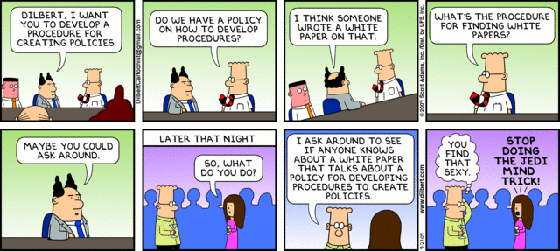
Notes:
Unlike Dilbert, you don’t have to start from scratch when creating a new policy. Many Commissions post their policies online and can serve as helpful templates for your own policies.
Ensure that you also refer to your particular set of standards, legislation, regulations, bylaws, etc. to help ensure your policies are in alignment with all applicable laws.
Consulting your own legal experts is also a crucial step in risk management.

Slide 13
Policy name & number
Purpose statement – What is the policy about?
Definitions – Define terms as you go, especially for words or phrases with multiple meetings.
Guidelines – a principle put forward to set standards or recommended actions or advise for guiding purposes only
Procedures – a series of detailed steps to accomplish the intent of the policy ( usually administrative in nature)
References – legislation, regulations, other related polices, etc.
7. Effective date/revised dates
Notes:
CREATE A POLICY STRUCTURE: After listing all the policies you wish to create, you’ll need to form a template for the finalized versions. Each policy should have a similar layout, including using the same font, which helps create a professional looking manual. Creating a similar framework for all your policies will also help you cover all the necessary aspects of each policy. It will also make the policies more consistent and easy to navigate. A common structure might include:
Policy name & number
Purpose statement – What is the policy about?
Definitions – Define terms as you go, especially for words or phrases with multiple meetings.
Guidelines – a principle put forward to set standards or recommended actions or advise for guiding purposes only
Procedures – a series of detailed steps to accomplish the intent of the policy ( usually administrative in nature)
References – legislation, regulations, other related polices, etc.
Effective date/revised dates
Your policies won’t be perfect on the first shot. After completing the first draft, you’ll need to gather feedback and insights from other leaders in your Commissions/Committees. Use whatever process is applicable to your agency, whether the policies need to reviewed by a sub-committee or go to a committee of the whole for approval.
How you communicate your policies after also plays a role in your manual’s effectiveness. Make it accessible to the public which will help in creating a culture of transparency and trust. Post online if you have your own website. Make sure you update and maintain your manual so that it is current and relevant.

Slide 14

Notes:
Let’s stop here for a minute. Are there any questions on developing a policy framework or policy/procedure writing?

Slide 15
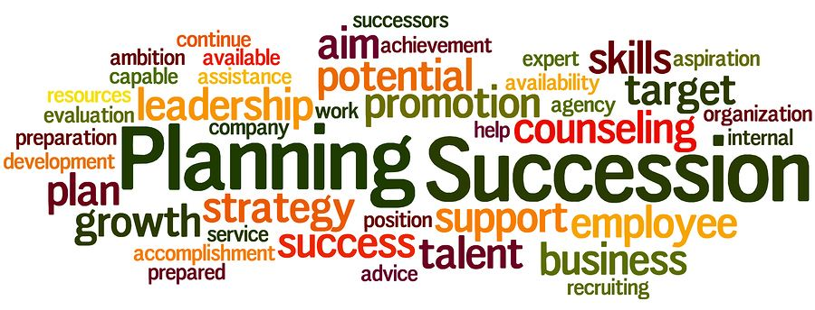
SUCCESSION PLANNING:
“The process of identifying successors to
key positions in the organization.”
Notes:
(This section deals with succession planning)
Succession planning is defined as “the process of identifying future successors to key positions in the organization”. It is part of a broad process of reviewing organizational requirements, identifying the essential skills needed for all key positions, and ensuring that management development programs are established or pursued to ensure that such skills are being established.
Why is succession planning important and why should Commissions/Committees ensure they address succession planning? We all know how important succession planning is in our respective Police Services to ensure the availability of qualified replacements with the required skill sets and competencies to fill unexpected or upcoming vacancies.
Even the Police Act states that Commissions are responsible for ensuring that sufficient persons are employed for the purpose of carrying out the functions of their police services – succession planning would ensure that this responsibility is carried out with a full complement of staff at all times.
All succession planning strategies, including ones for individual Commissions/Committees, should include systems that measure the development of skills, competencies, and required knowledge needed to fulfill their obligations as a governance and oversight board. The strategy should also incorporate coaching, mentoring, training, and recruitment methods that match these requirements.
In the case of the Edmonton Police Commission, Commissioners are appointed by City Council; however, recommendations are made prior to the selection process of the skills and competencies (or gaps) that the Commission requires. Our guidelines state that members are to be appointed on the basis of their skills and experience in a decision making capacity which can also include individuals within specialized areas of expertise such as financial, legal, risk management & audit, governance, HR, etc.

Slide 16
Notes:
The Calgary Police Commission, on the other hand, has a policy which lists minimum qualifications for Commissioner recruitment which lists the requirements an individual must have in the areas of education, experience competencies and personal suitability which must be met prior to being considered for a position on the board.
(Note: there are 2 slides which shows CPC qualifications. This slide contains education, experience & language. Second slide is competencies & personal suitability.)

Slide 17
Notes:
Second slide of CPC Qualifications for Commissioners. May want to highlight just a few.

Slide 18
“By crafting thoughtful, strategic approach to succession – the board fully addresses its governance responsibilities and sets any new leader on a firm course toward future success.”
Notes:
Good governance not only includes effective stewardship of resources (financial, human) but leadership succession within your Commissions/Committees is also a governance imperative as recruitment, development and retention of strong leaders are key to organizational success.
Being honest about the evaluation of your current talent on your boards/committees and committing to developing a system that ensures a rich pool of potential new candidates are just two ways where a diligent board can make a big difference.
Ideally, a strategic leadership transition begins with an organization that has practiced good governance and is therefore resilient and prepared to weather change. Leadership transitions work best when the organization has a shared sense of mission, vision, and values, knowledge of its impact in the community, an updated strategic plan, a strong and engaged board of directors, and a culture that recognizes the importance of board and staff development, among other things.
Additionally, organizations that have prioritized ongoing leadership growth are most likely to have a smooth transition and a successful outcome. This may manifest in various ways, from a robust board development program that includes an effective recruitment process and regular board member education.

Slide 19
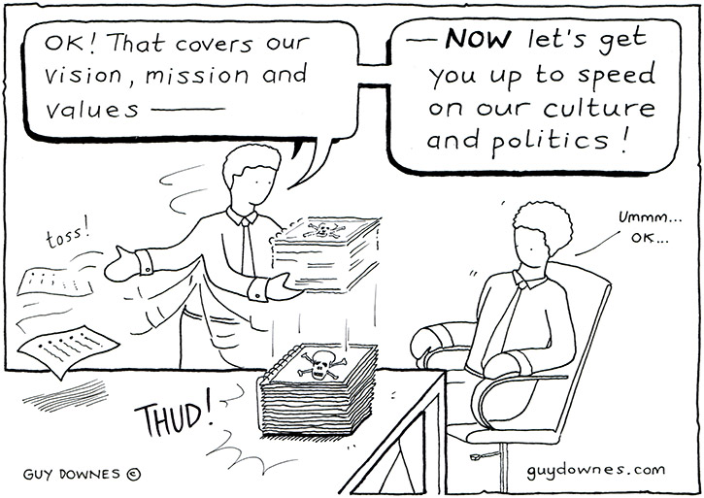
NEW MEMBER ON-BOARDING
Notes:
(This section deals with new member on-boarding)
A best practices transition focuses on both the on-boarding process and the first 12 months of a new Commissioner’s tenure which includes member orientation and training. Since all members of Commissions/Committees have term limits, it only stands to reason there will be frequent turnover and onboarding is crucial to the ongoing success of your organizations.
Proper onboarding isn’t just about first impressions. It takes time to plan an onboarding process that will meet the needs of your individual Committees or Commissions. Each of your organizations should have a designated onboarding leader that ensures all steps in the onboarding process are completed in a timely manner and that each new member is fully prepared prior to their first official meeting. This individual could be your ED, the Chair of your Commission/Committee, or another experienced board member. In any case, an onboarding leader can transform what might have previously been an informal, haphazard process into a means of increasing board effectiveness.
Many organizations also take their culture for granted. Any good onboarding process will not only be about processes and roles, but your organization’s vision and mission and values. Any new member should understand, from the onset, the critical challenges within your organization and an understanding of how they can help meet these challenges.
Also, don’t assume that the experience of new members who have served on other not-for-profit boards will necessarily translate to your board. Ensure you have arranged preliminary meetings with key personnel (or other members of Commission/Committee) to go over the technical workings of the board, its committee structure, and board governance policies.

Slide 20
Introduction to police governance and oversight in Alberta.
Overview of legislated roles and responsibilities, under the Police Act and Police Service Regulation, as well as applicable municipal bylaws, the Freedom of Information & Privacy Act (FOIP) and any other applicable provincial and federal legislation.
Overview of the public complaints process and the role of the Public Complaint Director.
Review of your policies and procedures manual (including agreeing to Code of Conduct).
Review of the Policing Oversight Standards.
6. Orientation on your specific organizations practises including:
meeting procedures & schedules, office procedures, roles &
responsibilities of any staff, budget & member expenses,
attendance at events, structure & function of committees,
communication protocols, and any other topics deemed
necessary.
Notes:
Many of your new members will come to you with widely diverse backgrounds, experiences and competencies. Consider customizing your onboarding process to meet the needs of each new member. A first time director on a board may need more orientation about the world in which your organization operates then say someone with a background in law enforcement or policing. Be sensitive to such differences and address them.
At a minimum the new appointees should have access to an onboarding orientation that outlines their roles and responsibilities as soon as practicable after their appointments. Training programs should also include the following:
Introduction to police governance and oversight in Alberta.
Overview of legislated roles and responsibilities, under the Police Act and Police Service Regulation, as well as applicable municipal bylaws, the Freedom of Information & Privacy Act (FOIP) and any other applicable provincial and federal legislation.
Overview of the public complaints process and the role of the Public Complaint Director.
Review of your policies and procedures manual (including agreeing to Code of Conduct).
Review of the Policing Oversight Standards.
6. Orientation on your specific organizations practises including: meeting procedures & schedules, office procedures, roles & responsibilities of any staff, budget & member expenses, attendance at events, structure & function of committees, communication protocols, and any other topics deemed necessary.

Slide 21
Orientation of New Members
New policing committee members will participate in an orientation session regarding their roles and responsibilities. This orientation shall take place as soon as practicable upon appointment.
New policing committee members will be given copies of (alphabetical):
Canmore Policing Committee Bylaw 2015-14; and
Canmore Policing Committee Policy Manual.
Policing committee members will receive an overview from the chair or designate regarding (alphabetical):
Communication strategies and policies (with members, policing committee staff, external services, media, public, police service, etc.);
Current goals of the policing committee;
Event schedules and expected attendance;
Meeting procedures and schedules;
Mission and vision of the policing committee;
Municipal Policing Agreement (MPSA);
Organizational structure of council;
Organizational structure of the RCMP detachment;
Notes:
Your individual police services should also present an onboarding presentation to all new members which highlights its organizational structure, roles of staff members and structure of different divisions or bureaus, legal and regulatory overview, rank insignia and hierarchical structure, plus other relevant information.
Finally, never rush prospective leaders into their new roles. It is beneficial to have a formal mentoring program where an experienced member connects with a newer member to provide insight into the board’s culture, explain what to expect at meeting, and suggest how best to contribute to deliberations. More importantly, a mentor can model leadership values and ensure new members also feel valued. So much is riding on the effectiveness of your organizations that experienced members should be doing all they can to accelerate the performance of new board members.
The example policy shown here is from the Canmore Policing Committee. It goes on to state other areas that new members are given information on such as committee structure & function, budgets, & ongoing developmental opportunities they can participate in including a mentoring program.

Slide 22

Notes:
(This section deals with continuing education)
Continuing education enables appointed members to enhance their understanding of the policing world and to be able to remain current regarding issues or governance matters which may impact your organizations. Commission member and Committee member orientation and training is an ongoing process and should continue throughout the term of membership. We all recognize the importance of continuous learning and I would encourage everyone to pursue and participate in ongoing education and training. This additional training can include presentations from your local services, as well as conference and seminar attendance and other external educational opportunities.
All Commissions/Committees should establish a yearly budget allowance to cover costs associated with training to cover things such as travel, registration, accommodations and meals as many of these additional educational opportunities are offered through member associations such as AAPG, CAPG, CACOLE, etc.

Slide 23

Webinars
Welcome to the CAPG Education Series! These webinars will bring CAPG stakeholders and colleagues together to explore a variety of topics of interest to our community. Our aim is to provide concrete resources to boards and other stakeholders to help in the development of effective governance. If you have a topic you would like us to cover, please contact us at: conference@capg.ca
2019 Webinar Series Bundle is available for purchase
Notes:
Other opportunities that might exist require no travel at all such as on-line courses and webinars. A couple of examples are:
The CAPG offers a host of webinars that bring stakeholders and colleagues together to explore a variety of topics of interest to your communities. Their aim is to provide concrete resources to boards and other stakeholders to help in the development of effective governance. (slide shows link to CAPG 2019 webinar series)
Alberta Justice & Solicitor General has an online training program for police commissions. Their modules include legislation, roles & responsibilities, meeting effectiveness, planning & priorities, public complaints, and an entire module on Chief selection, appointment & evaluation.
Of course there is also the ability to book and provide additional opportunities in-house using either resident experts and/or hiring external consultants to provide required training. For example, two opportunities that the Edmonton Police Commission took advantage of last year was media training and a meeting effectiveness and procedures session both delivered by resident experts in their fields. It might be beneficial to poll your members to see what types of opportunities they would like to see accessed that might enhance their skills and assist them in their respective roles on Commissions/Committees.
Providing effective leadership to your organizations is paramount and members must seek to constantly improve their skills in order to enhance their performance and to act with a long-term focus on the best interests of their organizations. Ongoing, continuing education is one way to achieve this goal.

Slide 24

Notes:
We’ll stop here for a few minutes to see if there are any questions on succession planning, on-boarding, or continuing education.

Slide 25
5 Best Practices for Board Evaluation:
Every board member should understand, accept, and support the need for doing annual board evaluations.
Each board member should share the commitment to evaluating themselves and their peers.
The board should agree on a well-planned, systematic process for conducting evaluations.
Select evaluation tools that will help you reach your objectives in evaluating the board.
Perform follow-up tasks to ensure that the board will address any areas of concern that the evaluations brought to the surface.
Notes:
(This section deals with the annual board performance assessment)
Just as leadership policies are central to good governance – the process of undertaking an annual board evaluation also contributes to effective governance and helps to increase performance as a whole. A formal assessment of your Commission/Committee as an entity will assist in identifying strengths, achievements and areas for improvement.
These assessments should measure how members perceive their Commission/Committee is performing its duties and a review of their current governance model and processes to ensure they are effective in carrying out your responsibilities. This process should involve input from all members, but may also include staff, Chiefs of Police / Officers in Charge (OIC’s), other stakeholders and the public.
Results from these evaluations should be used to inform strategic planning, policy development and address any missing skills or competencies on your respective Commissions/Committees. There is value in keeping your questionnaire the same year over year to allow benchmarking and to help identify trends.
Some areas you may also wish to consider to evaluate are the diversity and composition of the board, efficiency and effectiveness of board meetings, overall Chair assessment, complaints process, board governance and fiscal management, roles and informed decision making, just to name a few.
Of course, any tool you decide to use becomes a pointless exercise unless you address the “so what” or “what next” at the end of the evaluation. The survey results should be interpreted so as to create a list of recommendations for further review or areas of improvement. In this way your self-assessment will ensure that there remains a focus on the vision of your organization and that decisions are being made in accordance with the mission and through the lens of a set of values. Remember to celebrate your successes in some areas and begin the work to augment others

Slide 26
Why do you need Best Practises for Records Management?
Notes:
A compliant records management program is necessary for organizations to proactively manage all data and to demonstrate “good faith” intentions to follow best practises consistently and accurately.
Your corporate records are a valuable asset that must be managed throughout their lifecycle and preserved for future use. All Commissions/Committees should establish a record and information management framework and procedures to capture, protect, use and preserve records under your control.
There are many different “types” of corporate records and can include documents, reports, electronic correspondence (emails) and can also include photos or any other information that is recorded (audio/visual).
The management of your corporate records must comply with all business requirements, applicable legislation and government legislation (example: FOIP) and any municipal policies or bylaws on records retention. All records created by a Commission/Committee should be classified as per a records classification system and retention schedule developed for your organization. It is important to conduct legal research to determine what the retention period for each class of record must be and you should consider acquiring the assistance of consultants or external records management experts.
Training and education is essential to ensure an effective records management program. Official policies and procedures on the subject matter will ensure everyone understands where official records are to be saved and how they can be disclosed.

Slide 27
An organization with successful records management practises will:
Preserve information for the correct length of time
Meet legal requirements effectively & efficiently
Demonstrate proven practises of good faith
Archive vital information for business continuity
Provide information in a timely & efficient manner
Use technology to manage & improve program
Integrate policies & procedures throughout organization
Arrange for continuous training & communications throughout organization
Review, audit & improve program continuously
Notes:
This slide shows some of the additional reasons why you need a comprehensive document management system (highlight a few if time permits).

Slide 28
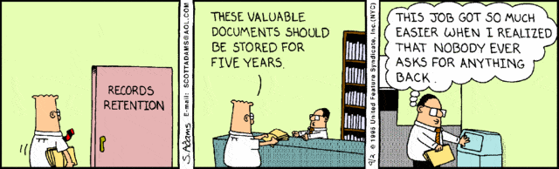
Notes:
Unlike Dilbert, you will receive requests from the public for access to information and disclosure of records that are in your control.
Commissions, as a statutory body under the Police Act, are designated the “Head” when it comes to the FOIP Act and are responsible to respond to requests for information.
All Commissions/Committees should support the principle of reasonable access to records as it enhances transparency and public confidence. You should make every effort to assist applicants in an open and complete way.

Slide 29
Notes:
Materials that have been considered in a public meeting should be made available without making a request under the Act. This would include agendas, minutes and reports presented to your Commission/Committee. Application for disclosure of records that have not been considered in public meetings will need to be processed according to the provisions of the FOIP Act. Make sure you emphasize that all personal business (including emails) should be kept separate from your business emails as they will become part of the official record in the management system and could be subject to disclosure as well.
This slide is a tip sheet from the Office of the Privacy Commissioner for Alberta and outlines 8 tips for managing emails, both personal and business. You will note Tip #2 which states: “Don’t include personal messages in business emails as they will become part of the official record retained in the corporate records management system.” These tips are derived from the “Guidelines for Managing Emails” document which is also available on their website.

Slide 30
Edmonton Police Commission Meeting Procedures:
PREPARATION OF MINUTES: The Meeting Coordinator will prepare all Commission minutes which include:
all motions;
the names of the members present and absent from the meeting;
the name of the member who moves a motion and the seconder;
declarations of pecuniary interest made under the Municipal Government Act, or any other legislation or bylaw by any member, or any resolutions excusing a member from voting.
ADOPTION OF MINUTES: The minutes of each meeting must be circulated prior to the meeting at which they are to be adopted. If there are no errors or omissions, the Commission may adopt the minutes by unanimous consent. If there are errors or omissions, the Commission must:
pass a motion to amend the minutes; and
adopt the minutes as amended;
Notes:
(This section deals with minute taking)
Minute taking can be complex, tricky and challenging. Minute takers are often
expected to produce concise and coherent summaries out of chaotic and disorganized meetings. Many are directed to take minutes without documented guidelines on what to record and what to leave out, and without a prior explanation of issues and technical terms used at a meeting. Just as your agendas are important for outlining the order of business at your meetings, minutes of meetings are also important documents, for recording consensus and decision-making, and for tracking the evolution of issues and the history of an organization.
Minutes should follow the same form, general look and style, across all your meetings. They should not include subjective interpretations of the mood or tone of the meeting nor should they attribute specific remarks to any one individual such as “There was a heated discussion” or “Mr. Smith responded with…” Robert’s Rules of Order (Newly Revised) dedicates an entire section to minute and report taking and includes suggestions for content, format and approval processes.
This slide shows an excerpt from the Edmonton Police Commission’s Meeting Procedures policy which addresses minute taking and the format they shall take.

Slide 31
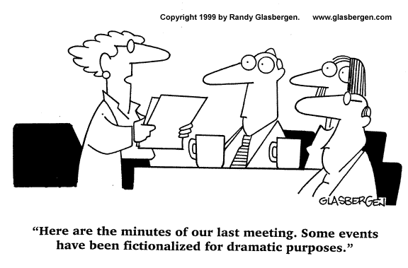
Notes:
Minutes should be kept of all Commission/Committee meetings, including meetings held in camera. There are no generally adopted procedures for recording in-camera minutes.
Experts on parliamentary procedure, such as Eli Mina (Board effectiveness consultant and Registered Parliamentarian), recommend that in camera minutes follow the same standards you have adopted for regular, public meetings. It is important to note that minutes of in camera meetings have evidentiary value and should never be destroyed. It should be noted that meeting minutes, in camera or otherwise, are not to be a verbatim transcription of deliberations.
I would point out that minutes of in camera meetings are a necessary risk management practice that balances the desire for full public disclosure and privacy protection for reasons of confidentiality of personnel, legal and other matters.

Slide 32


Notes:
That’s the end of my presentation. Are there any further questions on the last three topics I covered or any other questions on internal processes?
Thank you’s.

